Slide 1
Web Page Phishing Detection
By: Santos A. Romero

Slide 2
The Task:
To create an AI model that can predict whether a URL link is malicious in nature or from a legitimate business/organization.
The Data:
The provided dataset includes 11430 URLs with 87 features, 56 extracted from the structure and syntax of URLs, 24 extracted from the content of their correspondent pages, and 7 are extracted by querying external services. The dataset is balanced, it contains exactly 50% phishing and 50% legitimate URLs.

Slide 3
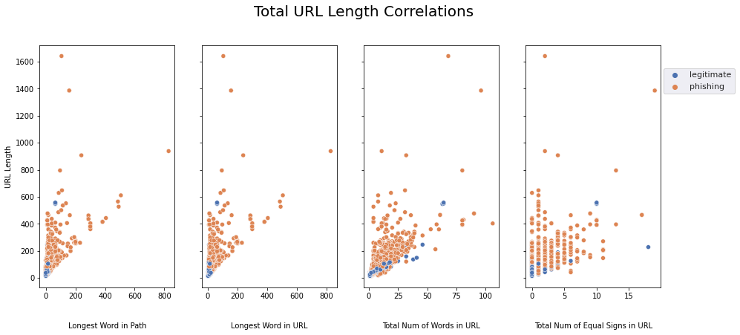
Key Findings (1)
Some assumptions proved factual.
The belief that phishing URLs are longer was proved correct in all aspects.
Length of words
Number of total words
Number of total special characters.

Slide 4
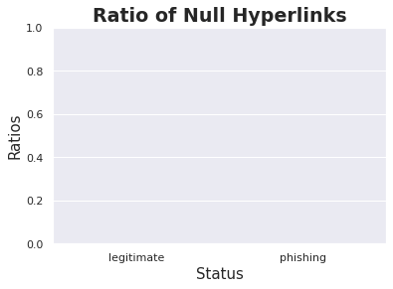
Key Findings (2)
Some assumptions proved false.
The belief that phishing URLs would contain many fake hyperlinks to mimic the hyperlinks on legitimate websites.
Both legitimate and phishing URLs have 0 null hyperlinks.
Phishing URLs are better made than expected

Slide 5
Strengths of Model
With a 96% accuracy, my final AI model can almost perfectly predicts whether a URL is legitimate or a phishing attempt.
False positives account for predicting if a URL is a phishing attempt and it is legitimate while false negatives accounts for predictions that a URL is legitimate and it is actually a phishing attempt.
Our model has a low false negative rate, it will rarely predict a malicious URL incorrectly as a legitimate URL.
Though this is balanced by a higher false positive rate.

Slide 6
Limitations of Model
False positives account for predicting if a URL is a phishing attempt and it is legitimate while false negatives accounts for predictions that a URL is legitimate and it is actually a phishing attempt.
Our model has a higher false positive rate, meaning there will be safe websites that may get flagged as phishing attempts.
Though this is balanced with a low false negative rate.

Slide 7
Final Recommendations
My final model performed very well on the data used to train and test its ability to differentiate legitimate from phishing attempt URLs.
It could be improved to decrease false negatives even further, while this would increase false positives, predicting a legitimate website as a phishing attempt can be ignored given previous knowledge of the URL and company needs but predicting a phishing attempt as a safe URL could be devastating for a company/organization.
As it currently is, it is fine for network environments without highly sensitive data but for networks that need higher level security, I would recommend that change.

